Slide 1

Introduction to Parallel Computing
By
Dr. Nileshchandra Pikle
Assistant Professor
Indian Institute of Information Technology Nagpur

Slide 2
Agenda
Moore’s Law
Why Parallel – Some applications
Top 500 supercomputers
Parallel Computing Architectures and Programming Models
Recap – Computer Architecture concepts

Slide 3
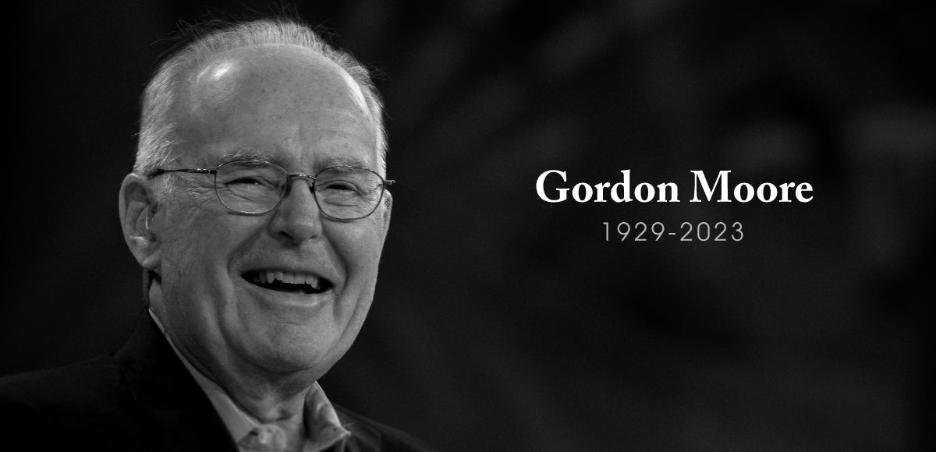
Moore’s Law
Moore's law is the observation that the number of transistors in an integrated circuit (IC) doubles about every year. - 1965
In 1975, looking forward to the next decade, he revised the forecast to doubling every two years.
Moore's second law, says that the cost of a semiconductor chip fabrication plant doubles every four years
In July 1968, Robert Noyce and Moore founded NM Electronics, which later became Intel Corporation.

Slide 4
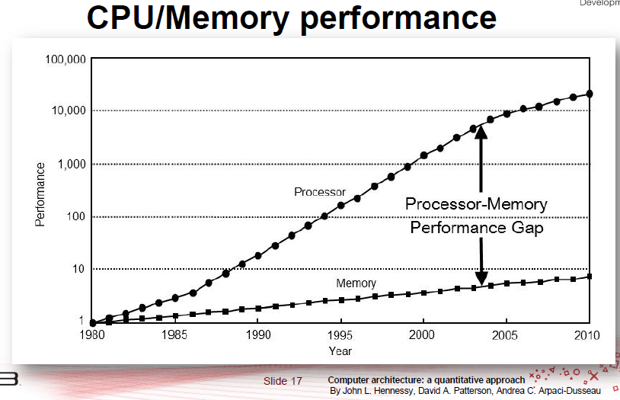
Why Parallel?
Can’t increase clock frequency rapidly
Even though processors speed roughly getting doubled every two years but DRAM access time remains bottleneck (~+10% per year)
Multiple processors can access memory in parallel
Benefits of different levels of cache memories – L1 , L2, L3

Slide 5


Why Parallel?
Some complex problems demand computing power to provide output within desired timeline
N – Body Simulation : for 1 million bodies simulation requires days per iteration

Slide 6



Why Parallel?
Some complex problems demand computing power to provide output within desired timeline
2. Movie Making: A few minutes of video takes weeks of rendering time

Slide 7

Why Parallel?
Some complex problems demand computing power to provide output within desired timeline
3. Financial Computations: Investing at right time, Market Prediction

Slide 8
Parallel Architectures
&
Programming Models

Slide 9
Parallel Architectures & Programming Models
Parallel Architecture
Programming Model
Shared Memory
Shared Memory
Distributed Memory
Message Passing
Hybrid
Shared Memory + Message Passing

Slide 10
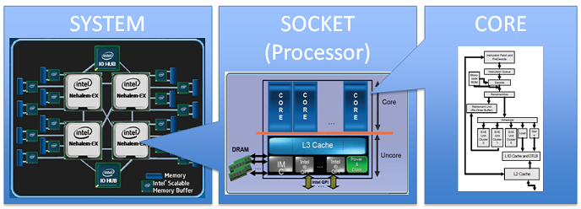
Parallel Architectures
Shared Memory
Processor Bord
Processor Socket
Processor Socket
Processor 0
Processor 1
Core 0
Core 1
Core 0
Core 1
L1 Cache
L1 Cache
L1 Cache
L1 Cache
L2 Cache
L2 Cache
L3 Cache
HDD
RAM

Slide 11
Parallel Architectures
Shared Memory
Processor Bord
Processor Socket
Processor Socket
Processor 0
Processor 1
Core 0
Core 1
Core 0
Core 1
Shared Memory is accessible to all computing resources
Communication between cores happen through shared memory
There is a common bus between processors and the shared memory
Limitation is number of processors – often we get max 32 cores per CPU
L1 Cache
L1 Cache
L1 Cache
L1 Cache
L2 Cache
L2 Cache
L3 Cache
RAM

Slide 12
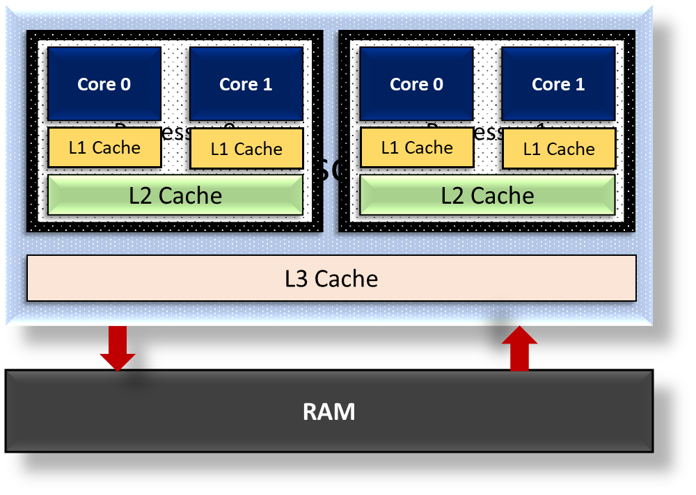
Parallel Architectures
Distributed Memory
Each computing node has its own memory
Communication happens by sending / receiving messages
No limit on number of processors! - We can add as many as processors we want
However, bottleneck will be the network
Network

Slide 13
Parallel Architectures
Hybrid
It is just the combination of both shared and distributed memory
Every node has its own shared memory – Cores within the node share the memory address space.
Within the node communication happens through shared memory
The several nodes are connected over a network and communicate over the network by message passing
Network

Slide 14

Parallel Programming Models
Shared
Global Address Space
This assumes all cores share a common global memory address space.
All the tasks executing in parallel get to see same address space
Communication happens by read/write operations in the shared memory (global address space)
Write
Read
Task 1
Task 2
Task 3
Task N

Slide 15

Parallel Programming Models
Message Passing
Private
Address Space
Private
Address Space
Task 1
Task 2
This assumes all computing resources have a separate memory address space.
All the tasks executing in parallel has its own private address space
Communication happens by send()/receive() operations over the network
Receive()
Task 3
Task N
Send()
Private
Address Space
Private
Address Space

Slide 16
Computer Architecture Recap

Slide 17
Computer Architecture - Pipeline
Processor cannot operate directly on main memory
Calculations are performed by using registers
Read/Write operations first happens in registers
The speed of a processor is determined by clock frequency E.g. 1 GHZ processor means a processor is capable of executing 10^9 instructions per seconds
Every program instruction is further divided into h/w level instructions – Fetch, Decode, Execute, Write.
Control
Unit
Registers
ALU
Main Memory

Slide 18
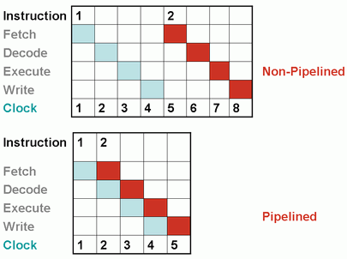
Computer Architecture - Pipeline
Overlapping the instruction execution sequence to reduce overall execution time
Non pipelined version indicates instructions per clock cycle is ¼
Pipelined version indicates instructions per clock cycle is 1
Modern architectures have more than 20+ pipeline stages.
Issues with pipeline
1. Due to data dependency there might be some NoP (No
Operation) in pipeline
Add R1 10
Add R2 5
Add R1 3 This is dependent on first instruction as R1 is not free
2. Branching causes stalls / Bubbles in pipeline
3. To tackle these issues the control logic gets complex

Slide 19
Computer Architecture - VLIW
Very Large Instruction Word –
The limitations of the Superscalar processor are prominent as the difficulty of scheduling instruction becomes complex.
VLIW uses instruction level parallelism – ILP
VLIW Architecture deals with limitations of pipeline and superscalar architecture by depending on the compiler.
The processors in this architecture have multiple functional units, fetch from the Instruction cache that have the Very Long Instruction Word.
Multiple independent operations are grouped together in a single VLIW Instruction. They are initialized in the same clock cycle.
Each operation is assigned an independent functional unit.
Limitation of VLIW is “No view of dynamic state” it doesn’t know what is happening currently as everything is analyzed in advance by the compiler

Slide 20
Computer Architecture – Memory Latency
Main Memory
The address bus carries a memory address within the device. It allows the CPU to reference memory locations within the device.
Data bus transfers data from one location to another across the computer.
The control unit generates a specific control signal for every operation, such as memory read or input/ output operation.
Control
Unit
Registers
Data
ALU
Address
Control

Slide 21
Computer Architecture – Memory Latency
Main Memory
Latency: Time difference between data request and data supply
The performance of memory system depends on its ability to feed the data to the processor.
Typically processors performs faster than RAM
The speed of processor w.r.t. computations is measured as FLOPS – Floating-Point Operations Per Second
Control
Unit
Registers
Data
ALU
Address
Control

Slide 22
Computer Architecture – Memory Latency
Load R1, [R2] – 100 ns
Load R3, [R4] – 100 ns
MADD R5, R1, R3 – 20 ns
Matrix Multiplication code
for(i = 0; i < N; i++){
for(j = 0; j < N; j++){
for(j = 0; j < N; j++){
C[i][j] += A[i][k] * B[k][j];
}
}
}
R2 holds address of A[i][k]
R4 holds address of B[k][j]
MADD – Multiply ADD
Here we are performing 2 floating point operations per iteration
Multiply
Add
Number of operations = 2
Time = ~200 ns (lets skip 20 ns of MADD for the sake of simplicity)
FLOPS = 2 / 200 ns = 10 MFLOPS
Let processor – 1 GHz
Memory latency – 100 ns / 100 cycles
Word size = 4 bytes

Slide 23
Computer Architecture – Memory Latency
Load R1, [R2] – 100 ns
Load R3, [R4] – 100 ns
MADD R5, R1, R3 – 20 ns
Matrix Multiplication code
for(i = 0; i < N; i++){
for(j = 0; j < N; j++){
for(j = 0; j < N; j++){
C[i][j] += A[i][k] * B[k][j];
}
}
}
R2 holds address of A[i][k]
R4 holds address of B[k][j]
MADD – Multiply ADD
FLOPS = 2 / 200 ns = 10 MFLOPS
We assumed a processor of 1 GHz which can perform 10^9 operations per second
However actually we are getting 10 MFLOPS Only!
The performance is limited by memory latency.
Let processor – 1 GHz
Memory latency – 100 ns / 100 cycles
Word size = 4 bytes

Slide 24
Computer Architecture – Cache
Q. How to address the GAP between theoretical speed of a processor and actual speed
we are observing due to memory latency?
Use a cache memory – Smaller and faster between processor and memory
We cannot replace main memory by cache as it is costlier
Cache memory roughly 10 to 100 times faster compare to main memory.
IF data present in the cache
Access it
IF data present in memory
load into Cache

Slide 25
Computer Architecture – Cache
Matrix Multiplication code
for(i = 0; i < N; i++){
for(j = 0; j < N; j++){
for(j = 0; j < N; j++){
C[i][j] += A[i][k] * B[k][j];
}
}
}
Matrices are of size 64 x 64 and each matrix entry takes 4 bytes
Total memory required is 3 x 64 x 64 x 4 bytes= 48 KB
Lets assume the cache memory of size 1 MB
The access time for cache is 1 ns / 1 cycle
All the matrices can fit into cache memory and lets say we load all the matrices into cache memory
Load time for A and B = 64 x 64 x 100 ns
~= 800 micro seconds
Now it takes ~ 20 ns to complete one iteration of MMś
Load R1, [R2] – 1 ns
Load R3, [R4] – 1 ns
MADD R5, R1, R3 – 20 ns
Total time = 256k (iterations) x 20 ns + 800 micro seconds
Number of operations = (64)^3
FLOPS = 2 x (64)^3 / (64)^3 x 20 ns + 800 micro seconds
~= 90 MFLOPS

Slide 26
Computer Architecture – Memory Bandwidth
Memory Bandwidth: Rate at which data can be transferred between processor and memory
One way to increase the memory bandwidth is to increase the block size
A cache line is the smallest portion of data that can be mapped into a cache.
If you increase the block size in cache then more data to be placed in the same memory access
Which results into more cache hit and hence the improved FLOPS.
Way to increase the cache line is to increase the data bus however it is not feasible to increase data bus as it is costly to do so
Processor
CACHE
Block size
Memory

Slide 27
Flynn’s taxonomy
Flynn’s taxonomy is a classification scheme for computer architectures proposed by Michael Flynn in 1966.
The taxonomy is based on the number of instruction streams and data streams that can be processed simultaneously by a computer architecture.
SISD
SIMD
a single processor that executes a single instruction stream and operates on a single data stream.
a single processor that executes the same instruction on multiple data streams in parallel.
MISD
MIMD
multiple processors execute different instructions on the same data stream. This type of architecture is not commonly used in practice, as it is difficult to find applications that can be decomposed into independent instruction streams.
Multiple processors execute different instructions on different data streams. This type of architecture is used in distributed computing, parallel processing

Slide 28
Thank you

